Slide 1



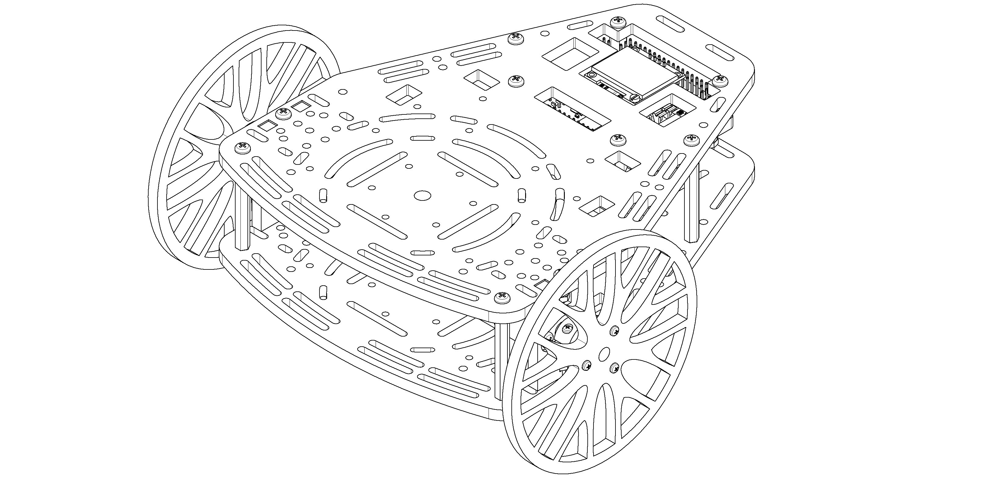
Control Systems in ROS
Puzzlebot Model
ROS tips and tricks

Slide 2
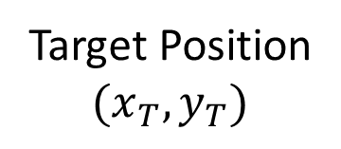
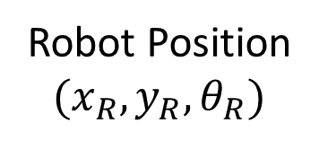
The Task
Target Position
$$(x_{T},y_{T})$$
Robot Position
$$(x_{R},y_{R},θ_{R})$$

Slide 3
The Control System
+
Error
Controller
Plant
Set Point
Control Signal
Output
-
Sensors
Measured
Output

Slide 4
The Control System
+
Error
Controller
Puzzlebot
Set Point
Control Signal
Robot Motion
-
Sensors
Measured
Output

Slide 5
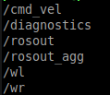





Determining the Robot Position
$$v$$
$$v_{Wheel}=rω_{Wheel}$$
$$r$$
$$ω$$

Slide 6
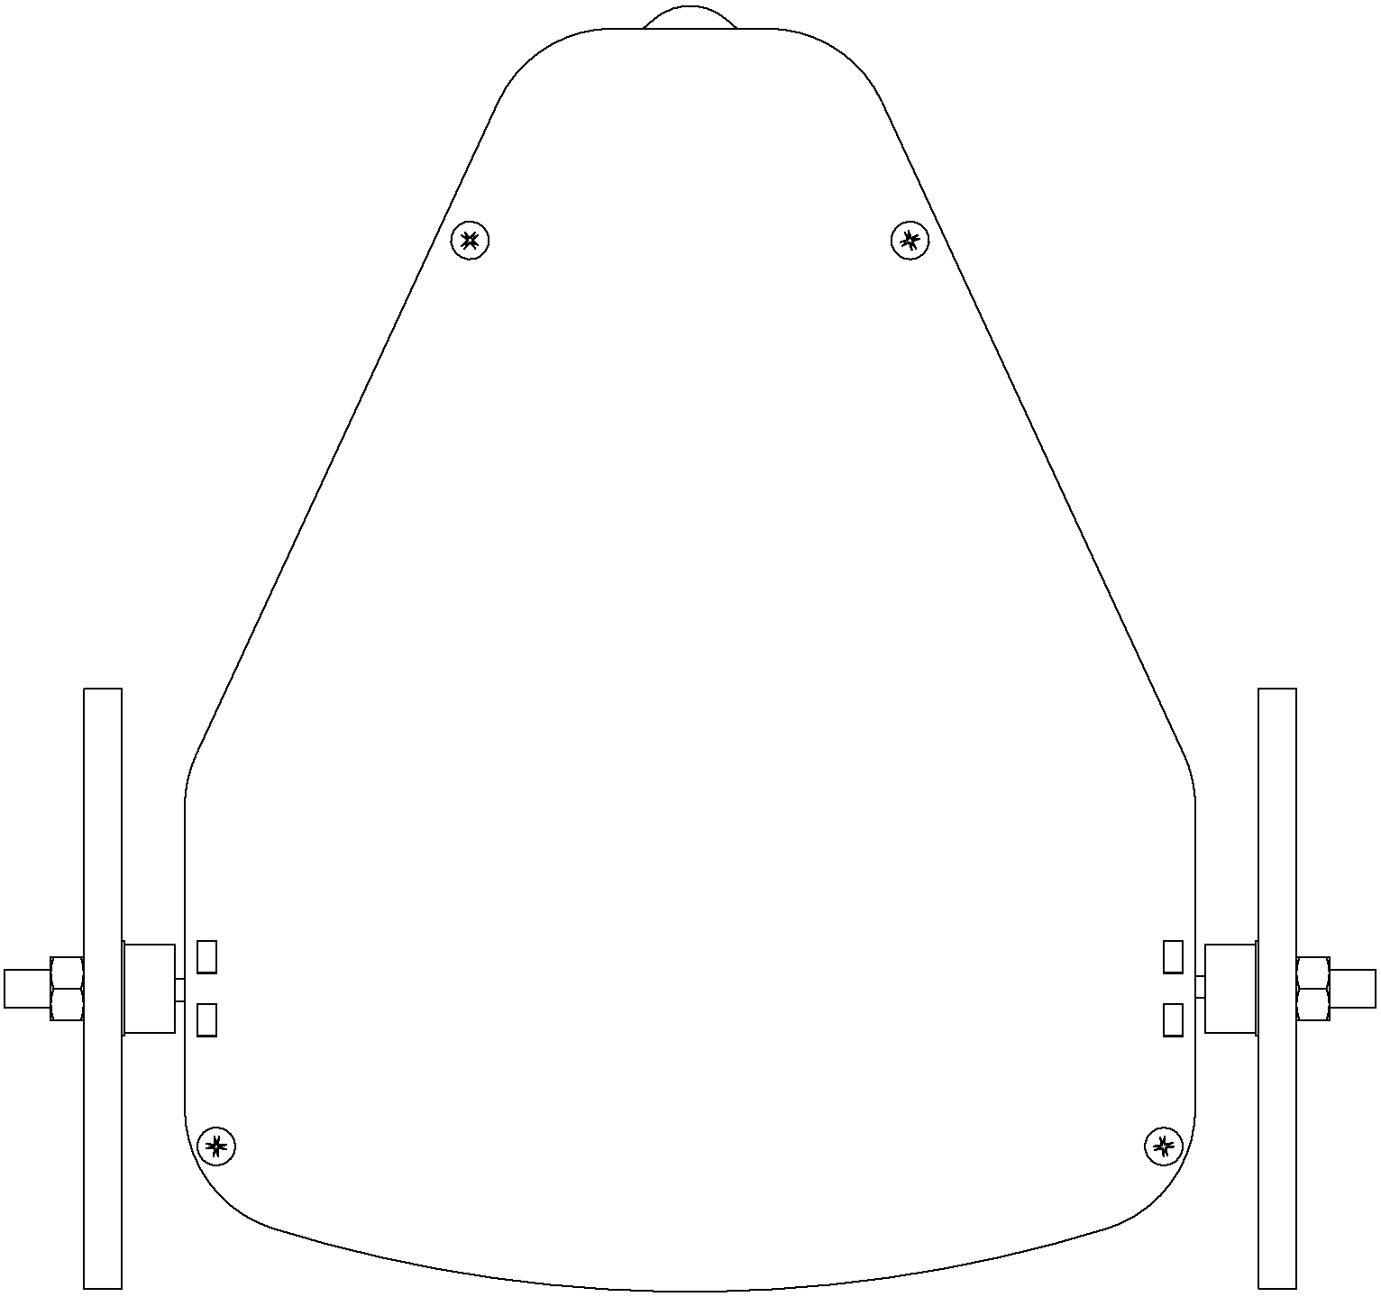










Determining the Robot Position
$$y_{w}$$
$$v_{Robot}=\frac{v_{R}+v_{L}}{2}=r\frac{ω_{R}+ω_{L}}{2}$$
$$ω_{Robot}=\frac{v_{R}−v_{L}}{l}=r\frac{ ω_{R}−ω_{L}}{l}$$
$$v_{R}$$
$$v$$
$$θ$$
$$y$$
$$v_{L}$$
$$ω$$
$$x$$
$$x_{w}$$

Slide 7
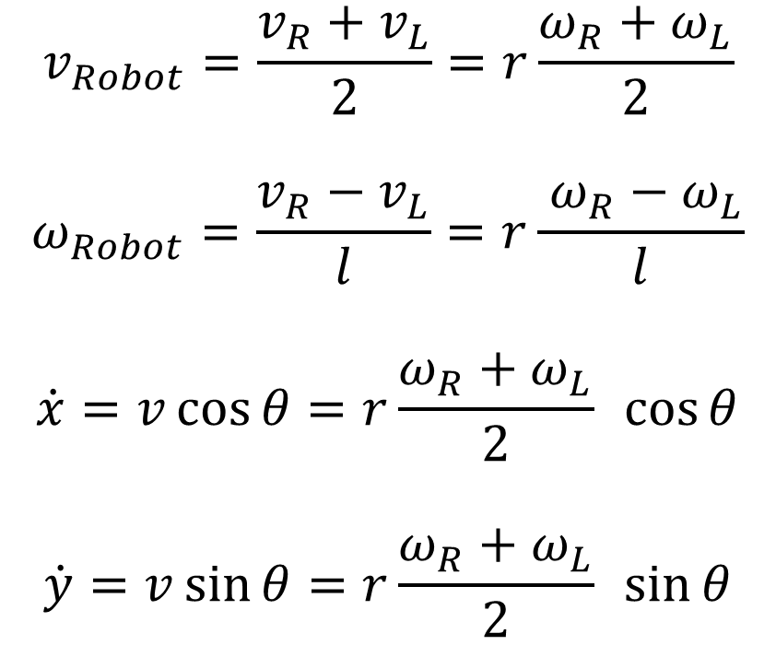
Determining the Robot Position
$$y_{w}$$
$$v_{Robot}=\frac{v_{R}+v_{L}}{2}=r\frac{ω_{R}+ω_{L}}{2}$$
$$ω_{Robot}=\frac{v_{R}−v_{L}}{l}=r\frac{ ω_{R}−ω_{L}}{l}$$
$$\dot{x}=v\cos{θ}=r\frac{ω_{R}+ω_{L}}{2} \cos{θ}$$
$$\dot{y}=v\sin{θ}=r\frac{ω_{R}+ω_{L}}{2} \sin{θ}$$
$$v_{R}$$
$$v$$
$$θ$$
$$y$$
$$v_{L}$$
$$ω$$
$$x$$
$$x_{w}$$

Slide 8

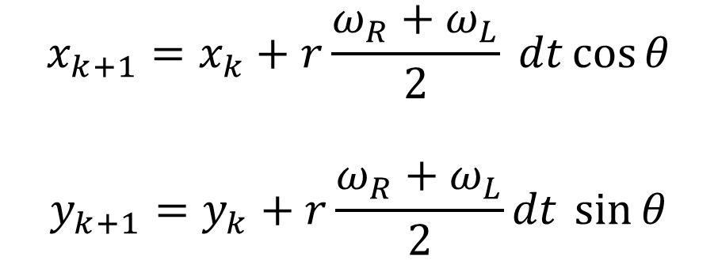
Determining the Robot Position
$$y_{w}$$
$$v_{R}$$
$$θ_{k+1}=θ_{k}+r\frac{ ω_{R}−ω_{L}}{l}dt$$
$$v$$
$$θ$$
$$y$$
$$x_{k+1}=x_{k}+r\frac{ω_{R}+ω_{L}}{2} dt\cos{θ}$$
$$y_{k+1}=y_{k}+r\frac{ω_{R}+ω_{L}}{2}dt \sin{θ}$$
$$v_{L}$$
$$ω$$
$$x$$
$$x_{w}$$

Slide 9
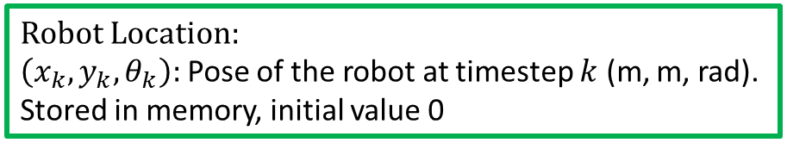
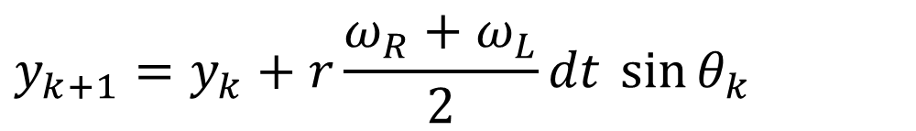
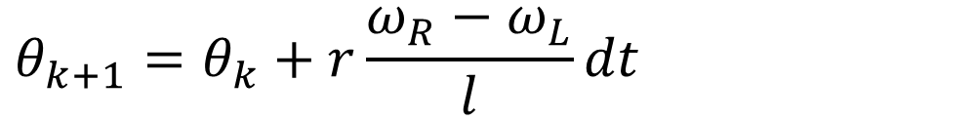
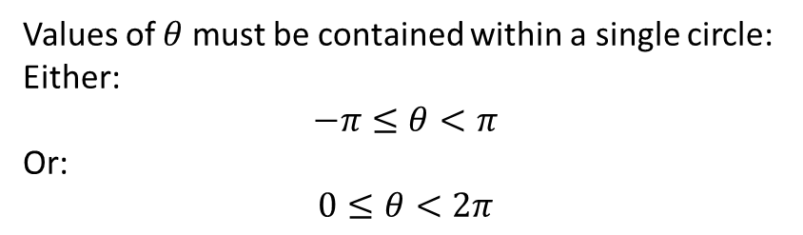
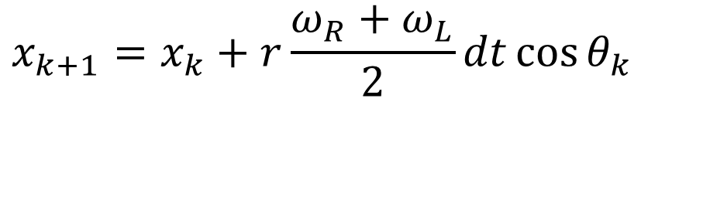
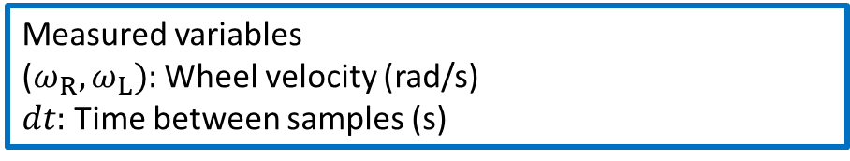
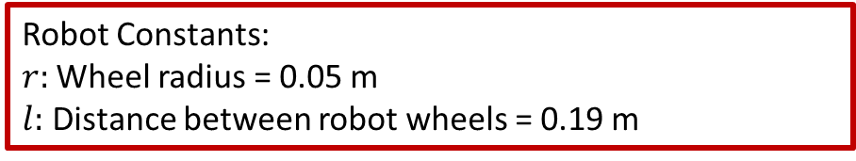
Determining the Robot Position
Robot Location:
$\left(x_{k},y_{k},θ_{k}\right):$Pose of the robot at timestep $k$ (m, m, rad). Stored in memory, initial value 0
$$θ_{k+1}=θ_{k}+r\frac{ω_{R}−ω_{L}}{l}dt$$
Robot Constants:
$r:$ Wheel radius = 0.05 m
$l:$ Distance between robot wheels = 0.19 m
$$x_{k+1}=x_{k}+r\frac{ω_{R}+ω_{L}}{2}dt\cos{θ_{k}}$$
Measured variables
($ω_{R},ω_{L}):$ Wheel velocity (rad/s)
$dt:$ Time between samples (s)
$$y_{k+1}=y_{k}+r\frac{ω_{R}+ω_{L}}{2}dt \sin{θ_{k}}$$
Values of $θ$ must be contained within a single circle:
Either:
$$−π≤θ<π$$
Or:
$$0≤θ<2π$$

Slide 10
Activity
Implement a ROS node that computes the robot location using the encoder data
It should subscribe to /wl and /wr, and publish the data to a suitable set of topics
The published messages could be a set floats, or you can combine them in any way you see fit

Slide 11

The Control System
Error
Error
Controller
PuzzleBot
+
Controller
PuzzleBot
Set Point
+
Set Point
Robot Motion
Control Signal
Robot Motion
Control Signal
-
-
Sensors
Encoders
$$(x_{R},y_{R},θ_{R})$$
Measured
Output

Slide 12




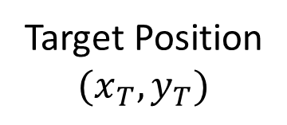
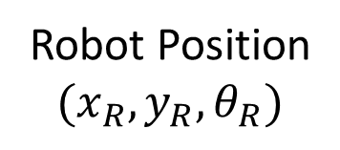
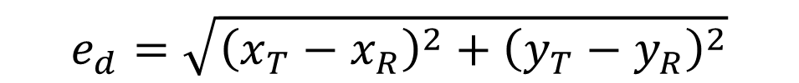
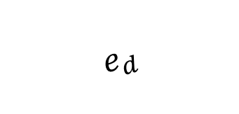

The Error
$$e_{d}$$
$$y(m)$$
$$e_{θ}$$
Target Position
$$(x_{T},y_{T})$$
$$θ_{R}$$
$$θ_{T}$$
$$x(m)$$
Robot Position
$$(x_{R},y_{R},θ_{R})$$
$$e_{θ}=θ_{T}−θ_{R}=atan2\left(x_{T},y_{T}\right)−θ_{R}$$
$$e_{d}=\sqrt{{\left(x_{T}−x_{R}\right)}^{2}+{\left(y_{T}−y_{R}\right)}^{2}}$$

Slide 13



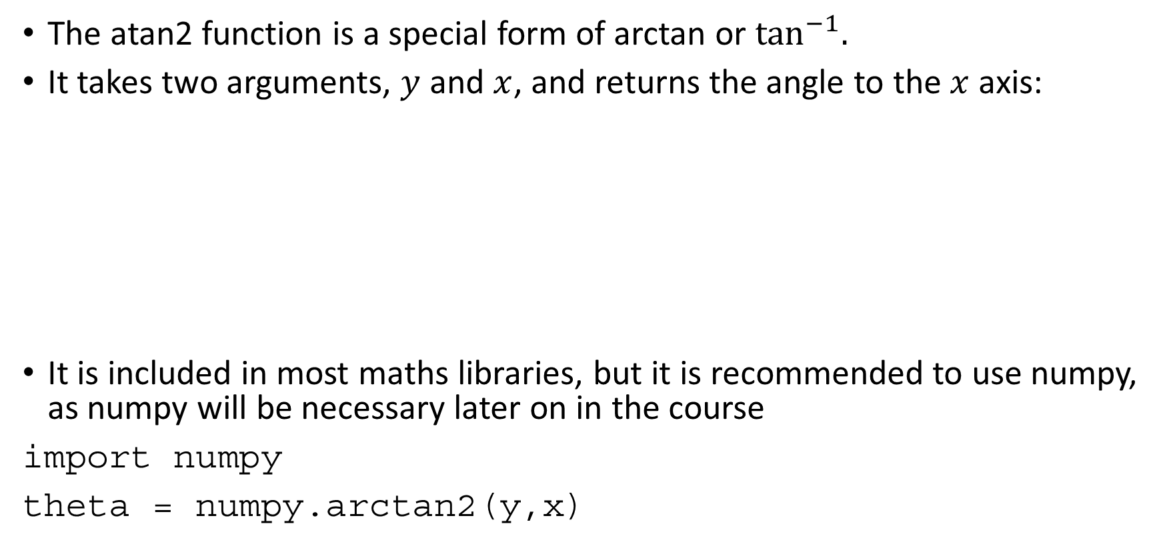

atan2
The atan2 function is a special form of arctan or $\tan^{−1}{.}$
It takes two arguments, $y$ and $x$, and returns the angle to the $x$ axis:
It is included in most maths libraries, but it is recommended to use numpy, as numpy will be necessary later on in the course
import numpy
theta = numpy.arctan2(y,x)
$$y$$
$$(x,y)$$
$$θ=atan2(y,x)$$
$$x$$

Slide 14
Activity
Modify the previous node to publish ed and etheta.
Set a target, and drive the robot around, checking that the angle to the target and the distance from the target are updated correctly
Remember to wrap all angles to within 1 circle

Slide 15



The Control System
$$\left(e_{d},e_{θ}\right)$$
Error
Controller
PuzzleBot
+
Controller
PuzzleBot
Set Point
+
$$(x_{T},y_{T})$$
Robot Motion
Control Signal
Robot Motion
Control Signal
-
-
Encoders
Encoders
$$(x_{R},y_{R},θ_{R})$$
$$(x_{R},y_{R},θ_{R})$$

Slide 16
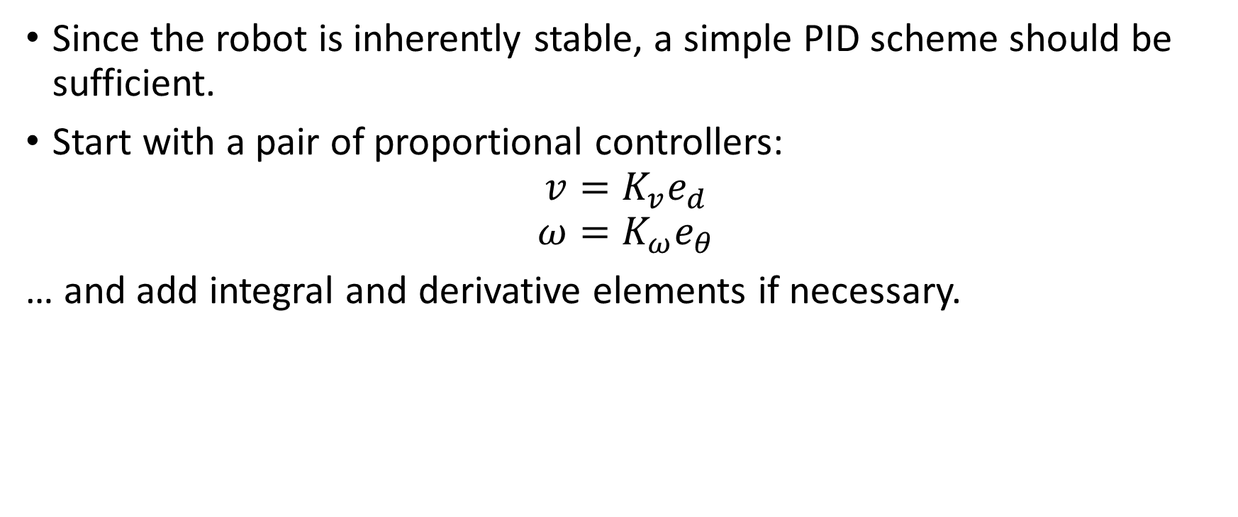
The Controller
Since the robot is inherently stable, a simple PID scheme should be sufficient.
Start with a pair of proportional controllers:
$$v=K_{v}e_{d}$$
$$ω=K_{ω}e_{θ}$$
… and add integral and derivative elements if necessary.

Slide 17



ROS setup
Subscribe to wheel speeds on /wr and /wl
Use wheel speeds to estimate robot position
/wr
Robot
Node
/wl
Compute the error in distance and angle $(e_{d},e_{θ})$
/cmd_vel
Controller
Node
Apply PID controllers to get $v$ and $ω$
Publish $v$ and $ω$ to /cmd_vel
Target Position

Slide 18
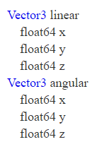
/cmd_vel
Message type: Geometry Messages – Twist
Import command in python:
from geometry_msgs.msg import Twist
6 fields accessed as follows:
msg.linear.x, msg.linear.y, msg.linear.z
msg.angular.x, msg.angular.y, msg.angular.z

Slide 19
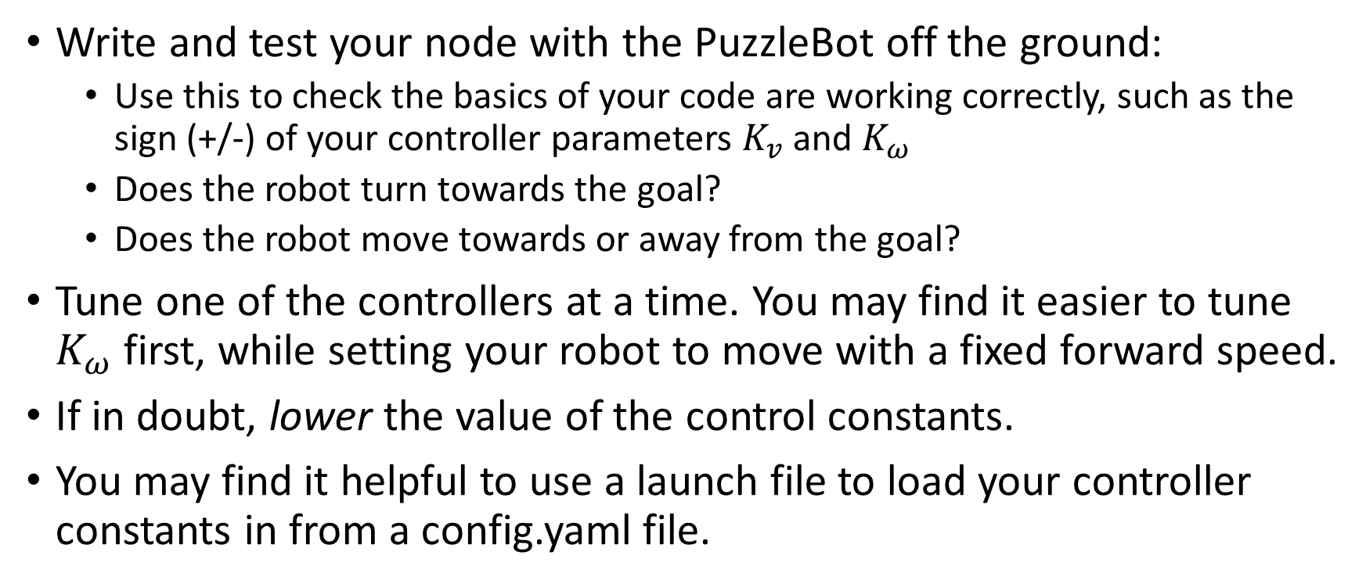
Tips and Tricks
Write and test your node with the PuzzleBot off the ground:
Use this to check the basics of your code are working correctly, such as the sign (+/-) of your controller parameters $K_{v}$ and $K_{ω}$
Does the robot turn towards the goal?
Does the robot move towards or away from the goal?
Tune one of the controllers at a time. You may find it easier to tune $K_{ω}$ first, while setting your robot to move with a fixed forward speed.
If in doubt, lower the value of the control constants.
You may find it helpful to use a launch file to load your controller constants in from a config.yaml file.

Slide 20
Accuracy
It will not be possible to tune the controllers such that the robot moves perfectly into position.
You will need a threshold after which your algorithm decides it has successfully arrived.
Suggested initial threshold: 10 cm
Additionally, if you measure the position of the robot, it will likely not match up with the measurement computed from the encoders.
This is inevitable due to additive noise in the encoder readings.
The solution to this is to use sensors that can measure the position of the robot relative to its environment.

Slide 21
ROS Tools ROS Launch Syntax
Launch files are sets of commands written in xml that allow executing various scripts at the same time.
The general syntaxis is the following
<?xml version=“1.0”?>
<launch>
[Body of the launchfile]
</launch>
This syntaxis allows to run any object used within the ROS architecture and has a wide variety of tools that allow to parametrize the launch file so that it can be adapted to the requirements of you project.
An extensive documentation can be found in http://wiki.ros.org/roslaunch

Slide 22
ROS Tools ROS Launch code tools
Running a node
<node name=“listener” pkg=“basic_comms” type=“listener.py” output=“screen”/>
Running another file or launch file
<include file="$(dirname)/other.launch" />
Set parameters
<param name="publish_frequency" type="double" value="10.0" />
Pass args to the launch file
<arg name=”camera_id" value=”cam_3" />
Load files into the system
<rosparam command="load" file="$(find package_name)/config/file_name.yaml" />

Slide 23
The Task
Target Position
$$(x_{T},y_{T})$$
Robot Position
$$(x_{R},y_{R},θ_{R})$$

